Slide 1
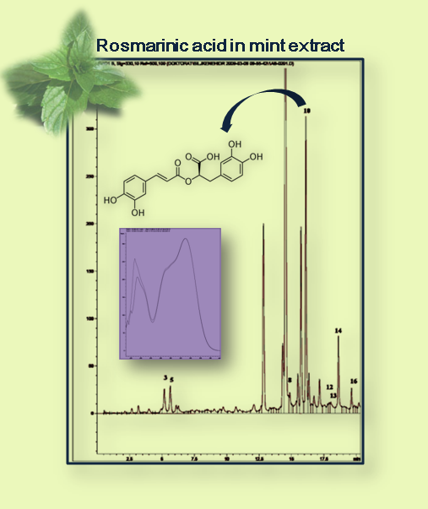
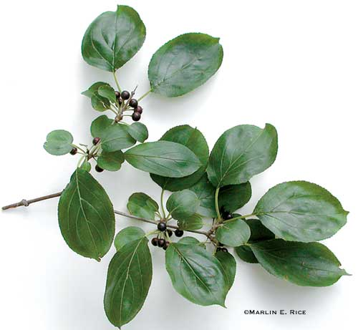
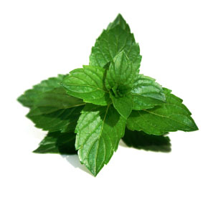
MEDICINAL PLANTS AS POTENTIAL FUNCTIONAL COMPONENTS IN FOOD AND FEED PRODUCTION
Aleksandra Mišanª, Neda Mimica-Dukić^{b}, Marijana Sakačª, Ivana Sedejª,
Anamarija Mandićª, Ivan Milovanovićª, Đorđe Psodorovª
ªUniversity of Novi Sad, Institute for Food Technology Novi Sad, Bul. cara Lazara 1, 21000 Novi Sad, Serbia
^{b}University of Novi Sad, Faculty of Science, Department of Chemistry, Trg Dositeja Obradovića 3, 21000 Novi Sad, Serbia
Introduction
The results of this experiment show that all the tested plant drugs are a rich source of plant phenolics (Table 1 and 2), and at the same time possess antioxidant activity in all of the tests (Table 3). Apart from the highest phenolic content, the mint extract was shown to possess the highest antioxidant capacity in all but in the β-carotene-antioxidant (AOA) test. Caraway fruit had the lowest content of total phenolics, as well as the lowest antioxidant capacity of all the tested samples.
The objective of this research was to evaluate the antioxidant activity of the ethanolic extracts of parsley fruit (Petroselini fructus), buckthorn bark (Frangulae cortex), mint leaves (Mentha piperitae folium), caraway fruit (Carvi fructus) and birch leaves (Betulae folium) as well as of the mixture of these medicinal herbs “Vitalplant“ (Frangulae cortex (35%), Menthae piperitae folium (20%), Carvi fructus (20%), Petroselini fructus (25%)), because these medicinal plants present a nontoxic source of the biomolecules with proven pharmacological action and a rich source of plant phenolics at the same time.
Table 3. Antioxidant activity of medicinal plants expressed as IC₅₀ (mg extract/mL): DPPH˙ radical scavenging activity, reducing activity, antioxidant activity by ß-carotene bleaching method (AOA) and chelating activity on Fe²⁺ions.
Sample | DPPH˙ scavenging activity IC₅₀ (mg/mL) | Reducing power IC₅₀ (mg/ml) | AOA IC₅₀(mg/mL) | Chelating activity IC₅₀ (mg/ml)
Mint leaves | 0.172 ± 0.002ª | 0.677 ± 0.108^{b} | 6.71 ± 0.160^{b} | 0.435 ± 0.180ª
Buckthorn bark | 1.18 ± 0.210^{c} | 1.76 ± 0.370^{c} | 1.38 ± 0.188^{c} | 1.39 ± 0.100^{c}
Birch leaves | 0.632 ± 0.005^{ab} | 1.07 ± 0.028ª | 5.68 ± 0.270ª | 0.602 ± 0.117ª
Caraway fruit | 2.06 ± 0.137^{d} | 5.27 ± 0.034e | 9.12 ± 0.233^{d} | 1.05 ± 0.099^{b}
Parsley fruit | 4.65 ± 0.820e | 4.68 ± 0.098^{d} | 6.32 ± 0.037^{b} | 0.583 ± 0.053ª
“Vitalplant“ | 0.893 ± 0.022^{bc} | 1.27 ± 0.257ª | 5.61 ± 0.543ª | 0.983 ± 0.037^{b}
Methods
Preparation of ethanolic extracts
Results and discussion
Crude plant extracts were obtained by extraction with ethanol/water mixture (80:20, v/v), with the ratio of raw materials to ethanol solution of 1:10, for 24 h. Hydrolisis of extracts was performed as described by Justesen et al., 1998.
Table 1. Extraction yield; total phenolic content of obtained extracts determined by Folin–Cioacalteu method, expressed as gallic acid equivalents; total flavonoids content of obtained extracts, expressed as rutin equivalents; total phenolic content of obtained extracts determined by HPLC, calculated as the sum of all integrated areas at 280 nm and expressed as gallic acid equivalents.
Values are means ± SD, n = 3. Values followed by different literals within each column indicate significant differences according to Duncan’s test (P < 0.05).
HPLC conditions and total phenolic
and flavonoid content
Conclusion
HPLC analysis was performed by using a liquid chromatograph (Agilent 1200 series), equipped with a diode array detector (DAD), on an Agilent, Eclipse XDB-C18, 1.8 μm, 4.6 x 50 mm column, at a flow-rate of 1 ml/min. Solvent gradient was performed by varying the proportion of solvent A (methanol) to solvent B (1% formic acid in water (v/v)) as follows: initial 10% A; 0-10 min, 10 -25 % A; 10-20 min, 25 - 60 % A; 20-30 min, 60-70 % A. The total running time and post-running time were 45 and 10 min, respectively. The column temperature was 30 °C and the injected volume 5 μl. The spectra were acquired in the range 210–400 nm and chromatograms plotted at 280, 330 and 350 nm with reference wavelength 550/100 nm. Total phenolics were determined by using Folin-Ciocalteu's reagent (Singleton et al., 1999). The content of flavonoids in the extracts was measured by the AlCl3 method (Lin and Tang, 2007).
Sample | Extraction yield (%) | Total phenolic content (%) | Total flavonoid content (%) | Total phenolics by HPLC method (%)
Mint leaves | 17.2 ± 0.75 | 18.4 ± 0.01e | 1.97 ± 0.04^{b} | 61.1 ± 1.25e
Buckthorn bark | 22.0 ± 0.89 | 16.6 ± 0.08^{d} | 1.33 ± 0.20ª | 21.2 ± 0.90^{c}
Birch leaves | 26.1 ± 0.82 | 13.9 ± 0.36ª | 1.43 ± 0.01ª | 27.9 ± 1.05ª
Caraway fruit | 19.5 ± 0.73 | 2.89 ± 0.02^{b} | 1.78 ± 0.07^{d} | 14.2 ± 0.95^{b}
Parsley fruit | 11.6 ± 0.62 | 7.13 ± 0.86^{c} | 0.510 ± 0.01^{c} | 23.9 ± 1.01^{d}
“Vitalplant“ | 17.3 ± 0.54 | 13.2 ± 0.95ª | 2.05 ± 0.06^{b} | 29.28 ± 1,03ª
Finally, the results of this experiment show that the tested plant drugs possess antioxidant activity in all of the tests. Commercial mixture “Vitalplant” exhibited a relatively high antioxidant activity in most of the tests, which can be explained by synergistic effects of the components of which it is composed.
Values are means ± SD, n = 3. Values followed by different literals within each column indicate significant differences according to Duncan’s test (P < 0.05).
Table 2. Content of plant phenolics in crude extract after hydrolysis, expressed as mg/g extract.
References
 | Mint leaves | Buckthorn bark | Birch leaves | Caraway fruit | Parsley fruit | “Vitalplant“
gallic acid | - | 0.156 ± 0.02 | 18.2 ± 0.38 | - | 11.6 ± 0.45 | 0.28 ± 0.01
protocatechuic acid | - | 0.845 ± 0.01 | 0.839 ± 0.11 | - | 0.466 ± 0.02 | 1.25 ± 0.01
caffeic acid | 0.914 ± 0.05 | 2.26 ± 0.01 | 0.576 ± 0.03 | 1.54 ± 0.26 | 2.26 ± 0.13 | 1.34 ± 0.01
vanillic acid | - | - | - | - | - | -
chlorogenic acid | 1.66 ± 0.29 | 0.353 ± 0.02 | 0.295 ± 0.03 | 1.32 ± 0.03 | - | 0.88 ± 0.05
syringic acid | - | 1.47 ± 0.10 | - | - | - | -
ferulic acid | - | 0.886 ± 0.02 | 0.655 ± 0.02 | 0.52 ± 0.02 | - | 0.68 ± 0.02
rutin | - | - | - | - | - | -
myricetin | 5.37 ± 0.38 | 0.723 ± 0.01 | 6.02 ± 0.32 | - | - | 1.37 ± 0.02
rosmarinic acid | 17.5 ± 0.97 | - | - | 0.200 ± 0.08 | - | 4.93 ± 0.06
trans-cinnamic acid | - | - | - | - | 0.155 ± 0.01 | -
quercetin | 14.9 ± 0.95 | 1.68 ± 0.02 | 7.43 ± 0.35 | 4.36 ± 0.02 | 0.817 ± 0.01 | 4.21 ± 0.05
naringenin | 3.56± 0.22 | 5.00 ± 0.21 | - | - | - | -
luteolin | 13.6 ± 0.28 | 2.32 ± 0.12 | - | - | 0.559 ± 0.02 | 4.57 ± 0.06
kaempferol | - | - | 0.643 ± 0.03 | 6.33 ± 0.21 | 2.99 ± 0.03 | 1.06 ± 0.32
apigenin | 3.56 ± 0.26 | 1.97 ± 0.08 | 0.667 ± 0.06 | - | 5.02 ± 0.01 | 6.49 ± 0.012
aloe-emodin | - | 3.48 ± 0.24 | - | - | - | 2.21 ± 0.20
Decker, E. A., Welch, B. (1990) J. Agric. Food. Chem., 38, 674-677.
Espin J.C., Soler-Rivas C., Wichers H.J. (2000) J. Agric. Food. Chem., 48, 648-656.
Justesen U., Knuthsen P., Leth T. (1998) J. Chromatogr. A, 799(1-2), 101-110.
Lin J.Y., Tang C.Y. (2007) Food Chem, 101, 140–147.
Моure А., et al. (2001) Food Chem, 72, 145-171.
Oyaizu, M. (1986) Japanese Journal of Nutrition, 44, 307-315.
Singleton, V.L., Orthofer, R., Lamuela-Raventos, R.M. (1999) Methods Enzymology, 299, 152-178.
Antioxidant activity
Radical-scavenging activity against the stable DPPH˙ radical was determined following the procedure of Espin et al. (2000). Antioxidant activity of plant extracts, based on coupled oxidation of ß-carotene and linoleic acid was determined according to the method of Moure et al. (2001). The reducing power was determined by measuring the formation of Prussian blue at 700 nm (Oyaizu, 1986). Chelating activity of the extracts on Fe2+ ions was measured according to the method of Decker & Welch (1990)
14th International Symposium on Feed Technology “Feed technology, quality and safety”, 2nd Workshop “Extrusion Technology Applications in Feed and Food”

